Slide 1
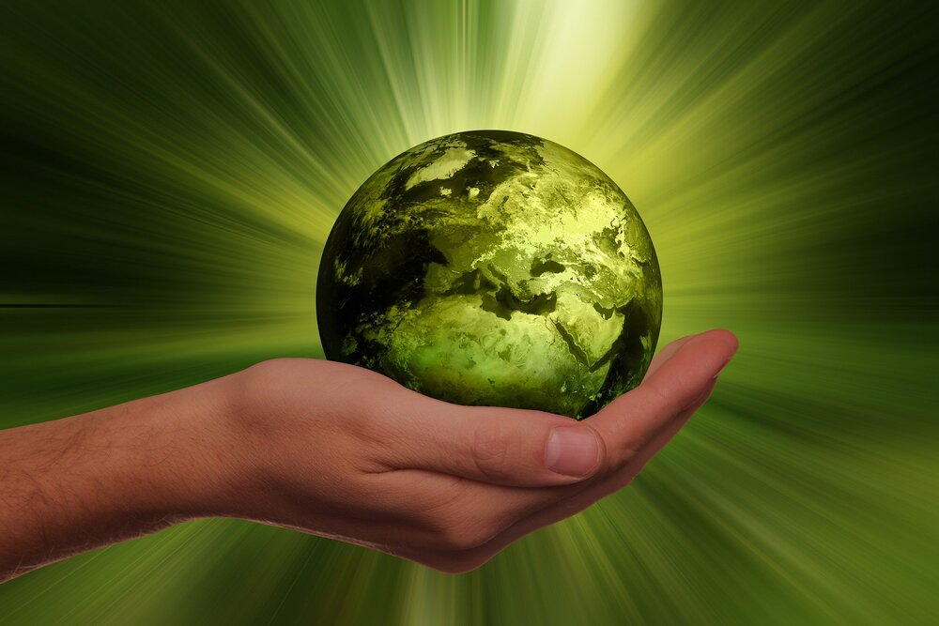
Module 6
SUSTAINABLE DESIGN
Dr Priyanjali Gogikar
SEEE, VIT Bhopal
priyanjali.gogikar@vitbhopal.ac.In

Slide 2

Sustainable design refers to the design process that integrates an environmentally friendly approach and considers nature resources as part of the design.
“Sustainable design is the practice of designing products so that they exist in harmony with natural systems.”
ENVIRONMENTAL
SOCIAL
ECONOMIC
SUSTAINABILITY

Slide 3
Lower operating costs
Lower consumption and pollution
Sustainable design
Increase life quality

Slide 4
Principles of sustainable design
Biomimicry principle
Learning from natural systems
Respect for energy and natural resources
Respect for people
Respect for Place
Respect for future
Systems thinking
Conservation principle
Human Vitality principle
Ecosystem principle
“Seven Generations” principle
Holistic principle
“We cannot solve our problems with the same thinking we used when we created them.” Albert Einstein

Slide 5
LIFE CYCLE ASSESSMENT
A Life Cycle Assessment (LCA) is defined as the systematic analysis of the potential environmental impacts of products or services during their entire life cycle.
During a Life Cycle Assessment (Life Cycle Analysis), you evaluate the potential environmental impacts throughout the entire life cycle of a product (production, distribution, use and end-of-life phases) or service.
This also includes the upstream (e.g., suppliers) and downstream (e.g., waste management) processes associated with the production (e.g., production of raw, auxiliary and operating materials), use phase, and disposal (e.g., waste incineration).

Slide 6
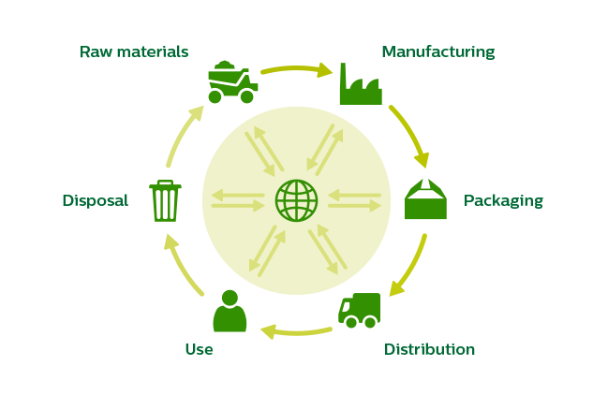
Four steps of LCA
Goal and scope definition
Inventory analysis
Impact assessment
Interpretation
Product life cycle

Slide 7
STEP 1: Goal and Scope of the product
In this phase, you define the product or service that you wish to assess, you choose a functional basis for comparison and you define the required level of detail. You then set a goal which determines the scope , including objective, application and audience. Lastly, you determine whether or not there has to be a critical review of that goal.
STEP 2: Inventory Analysis
Here you perform a data compilation and an inventory analysis of extractions from and releases into the environment. The final inventory provides a list of all inputs and outputs associated with the life cycle of your product or service.

Slide 8
STEP 3: Impact Assessment
In impact assessment, you classify resource use and emissions generated according to their potential impacts and quantify them for a limited number of impact categories, which you may then assess in terms of their relative importance for the goal of the LCA study.
STEP 4: Interpretation
With the above information, you discuss the results in terms of contributions, relevance, robustness, data quality and limitations, and you systematically evaluate any opportunities for reducing the negative effects of the product(s) or service(s) on the environment while avoiding burden shifting between impact categories or life cycle phases. Avoiding burden shifting is a core strength of the LCA approach.

Slide 9


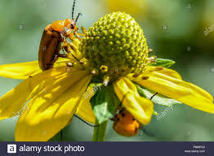
Nature as model (Janine Benyus, “Biomimicry”, 1996)
Nature runs on sunlight.
Nature fits form to function.
Nature recycles everything.
Nature rewards cooperation.
Nature banks on diversity.
Nature relies on local expertise.
Nature curbs excesses within.
BIOMIMICRY

Slide 10
BIOMIMICRY
Nature as measure
Nature suggests relative abundances and balances.
Nature demonstrates achievable rates.
Nature shows limits.

Slide 11
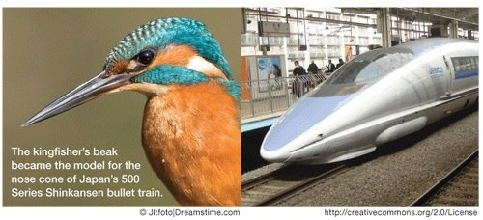
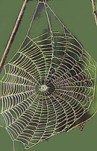
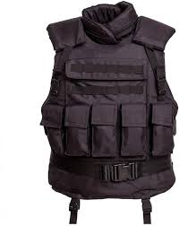
BIOMIMICRY
Nature as mentor

Slide 12
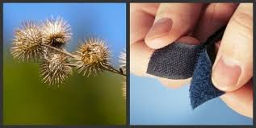
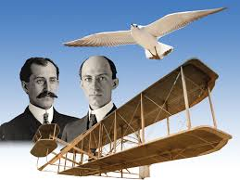
BIOMIMICRY
Bio inspiration
VELCRO

Slide 13
Eco-design
Eco-design consists of integrating environmental protection criteria over a service or a product’s lifecycle.
The main goal of eco design is to anticipate and minimize negative environmental impacts (of manufacturing, using and disposing of products).
Simultaneously, eco design also keeps a product’s quality level according to its ideal usage.
The principles of eco design where formally published in 2002 and they can be found in ISO/TR14062.

Slide 14
Eco-design means producing goods and services that meet your customers' needs while:
using the minimum levels of resources
having a minimum impact on the environment and society
Eco-design involves designing or redesigning products, services, processes or systems to avoid or repair damage to the environment, society and the economy.
Eco-design is present all around us - in sustainable flooring, green energy heating systems, eco-friendly packaging and even recyclable products.

Slide 15
environmental considerations at the heart of eco-design:
using materials with less environmental impact
using fewer materials overall in the manufacture of products
using fewer resources during the manufacturing process
producing less pollution and waste
reducing the environmental impacts of distributing products
ensuring that products use fewer resources when they are used by end customers
ensuring that products cause less waste and pollution when in use
optimizing the function of products and ensuring the most suitable service life
making reuse and recycling easier
reducing the environmental impact of disposal

Slide 16
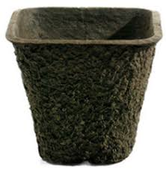
LED bulbs don’t have mercury and use significantly less energy compared to CFL bulbs.
Toothbrushes made out of bamboo are biodegradable and made from a tree that grows at an incredibly fast speed
Sustainable cellphone cases made from recycled plastic or wood
Examples of eco design
Bio degradable garden pots

Slide 17
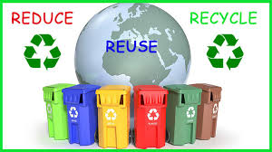
Recycling is the recovery of materials or components from products for processing.
The recycling of metals has been an established process for many years.
It is generally done through one of two methods: shredding and separation to recover both ferrous and non ferrous metals, and disassembly and recycling to recover metals and some other materials.
Plastics recycling is not as well established.
RECYCLING

Slide 18
RECYCLING
Plastics can be recovered using a variety of technologies.
The mechanical recycling of plastics involves melting, shredding and granulation of waste plastics. Plastics must be sorted prior to mechanical recycling into polymer types and/or color. The plastic is then melted down directly and moulded into a new shape or melted down after being shredded into flakes and then processed into granules called regranulate.
Some components such as PCBs, batteries,
specialist recycling. Many PCBs found in e-waste are not economic to recycle.

Slide 19
RECYCLING
Design for Recyclability
In the wake of concept of sustainable development, there has always been a thrust on environment preservation in the manufacturing sector. Various government regulations and circulars have been issued to employ the concept of design-for-recycling.
The design guidelines for “green” products and processes can be summarized as:
Increase efficiency of energy use, while considering environmental impact.
Minimize the amount of materials used.
Use recyclable and biodegradable materials where possible. remanufacturing

Slide 20
Social Innovation
“the practice of using creativity to develop solutions which improve the well being of people and society”
This practice promotes collaborative action, creative thinking and innovative action to address social need. It uses the experience and insight of those impacted and those concerned to come up with new solutions and approaches.
Social innovation can help to address local, national and global challenges in our world like inequality, poverty, climate change, racism, unemployment, suicide, mass migration, integration, loneliness, malnutrition etc.

Slide 21
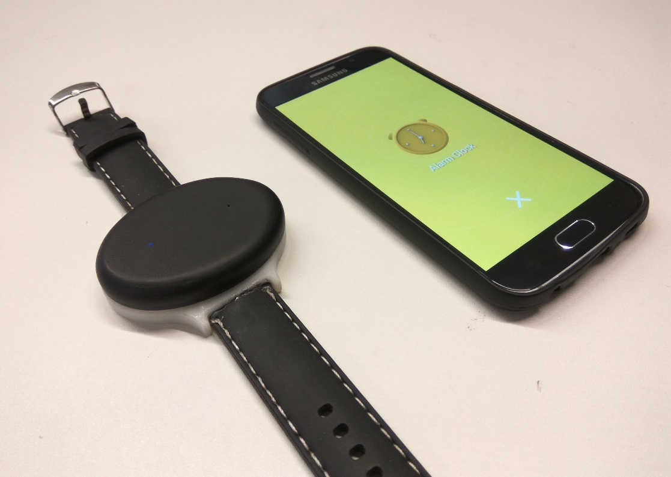
Social Innovation
“the practice of using creativity to develop solutions which improve the well being of people and society”
Blee: Wearable for the hearing-impaired
a wearable and easy-to-use affordable device that notifies hearing impaired individuals of specific activities and sounds; they ought to be vigilant about.
It does this by notifying the user through pre-recorded sound alerts using lights and vibrations. Every sound alert has a unique set of vibrations. The device is connected to the user’s phone via Bluetooth where all the sounds are pre-recorded and stored. The capacity of the device increases as the collection of pre-recorded sounds grow. The device can also be used independently as a smartphone application.

Slide 22
Social Innovation
“the practice of using creativity to develop solutions which improve the well being of people and society”
‘Smart collars’
use the GPS and accelerometer technology are ideal for tracking the movements of tigers. With the help of this satellite navigation technology that is fitted into a collar around a tiger’s neck, researchers are able to track its location and activities and take immediate action when needed.
ADITYA, India’s first solar ferry, was built by NavAlt Solar & Electric Boats, for the Kerala State Water Transport Department. The ferry is the first commercially viable mode of transport powered by solar energy in India. Aditya is also the first ferry in the world to have more than 80% of its energy requirements met through solar. It has a seating capacity of 75 passengers and on a bright, sunny day can cruise for more than 6 hours without the need for an external charge. It is built under the IRS (Indian Register of Shipping) class to the highest standards of safety and reliability.

Slide 23
Social Innovation
“the practice of using creativity to develop solutions which improve the well being of people and society”
Under The Mango Tree is a hybrid social enterprise that promotes beekeeping to increase agricultural productivity and provides market access to enhance income and improve the livelihoods of marginal farmers in India.
Under The Mango Tree works at both ends of the honey supply chain. Through its for-profit, UTMT Pvt. Ltd., it sources high-quality organic honey from farmer cooperatives, before packaging it for sale direct to customers

Slide 24
Thank You

